Slide 1
Week 2: Foundations
BCS 519 Stats in Perception
Ashley Clark

Slide 2
Outline
Analysis (fitting) vs. Prediction
All models are wrong (but some less so)
Linearity
Any conclusion are always contingent on the assumptions (model)

Slide 3
Fitting vs Prediction
Statistical models are used in a wide range of fields
Economics, education, environmental science, PSYCHOLOGY, and more…
Offer a powerful way to explain, predict, and describe data.
Sometimes ambiguity between causal explanation and for prediction
Can make a large difference as to what you really can learn from the model
Shmueli, G. (2010). To Explain or To Predict? Statisticcal Science, 25(3). doi:10.2139/ssrn.1351252
Notes:
Statistical models are used in a wide range of fields (ranging from economics, education, etc). This is a really powerful tool that can not only explain data, but can also be used to predict and describe aspects of the data that can lead to a better understand of the implications.
2. There is a lot of ambiguity between using models for causal explanation and for prediction.

Slide 4
Fitting vs Prediction
What is Predictive Modeling?
“The process of developing a mathematical tool or model that generates an accurate prediction about a random quantity of interest.”
https://bookdown.org/egarpor/PM-UC3M/intro-what-is.html
Notes:
In predictive modelling we are interested in predicting a random variable, typically denoted by YY, from a set of related variables X1,…,XpX1,…,Xp. The focus is on learning what is the probabilistic model that relates YY with X1,…,XpX1,…,Xp, and use that acquired knowledge for predicting YY given an observation of X1,…,XpX1,…,Xp. Some concrete examples of this are:
Predicting the wine quality (YY) from a set of environmental variables (X1,…,XpX1,…,Xp).
Predicting the number of sales (YY) from a set of marketing actions (X1,…,XpX1,…,Xp).
Modelling the average house value in a given suburb (YY) from a set of community-related features (X1,…,XpX1,…,Xp).
Predicting the probability of failure (YY) of a rocket launcher from the ambient temperature (X1X1).
Predicting students academic performance (YY) according to education resources and learning methodologies (X1,…,XpX1,…,Xp).

Slide 5
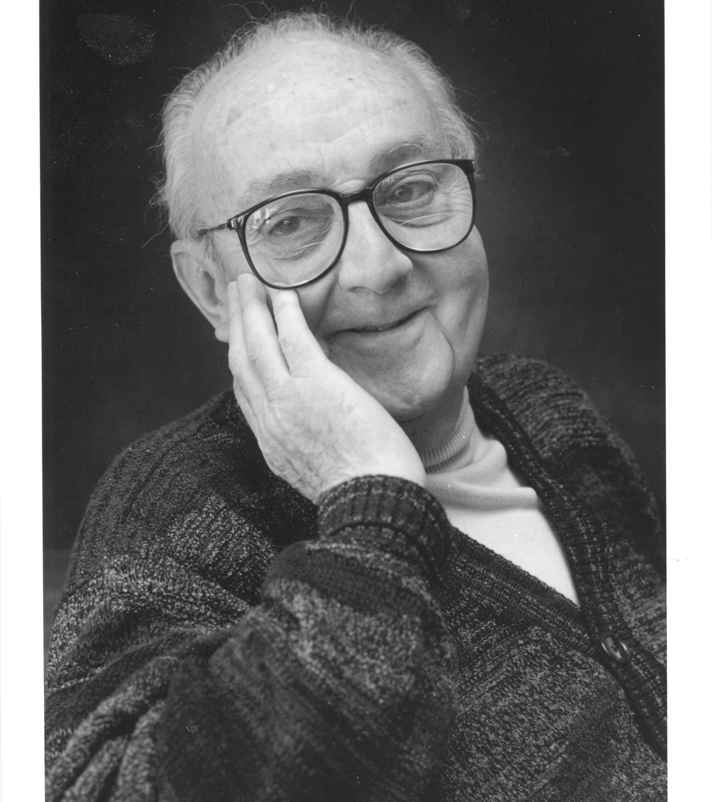
“All models are wrong, but some are useful” - George E.P Box
British Statistician
Notes:
every single model will be wrong, meaning that it will never represent the exact real behaviour. Having said that, even if a model cannot describe exactly the reality it could be very helpful if it is close enough.

Slide 6
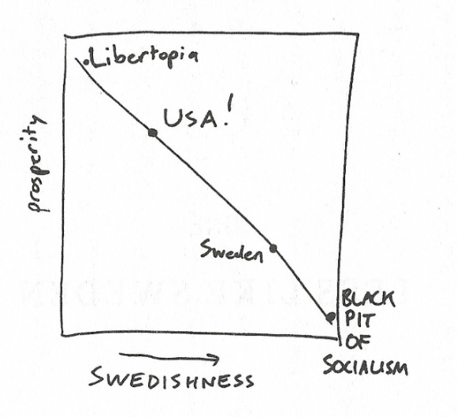
Linearity
It’s important to know what kind of data you have!
Without know the assumptions, you can violate the model’s predictability.
Ellenberg, Jordan “How Not to Be Wrong, The Power of Mathematical Thinking”, 2015 Chapter 1

Slide 7
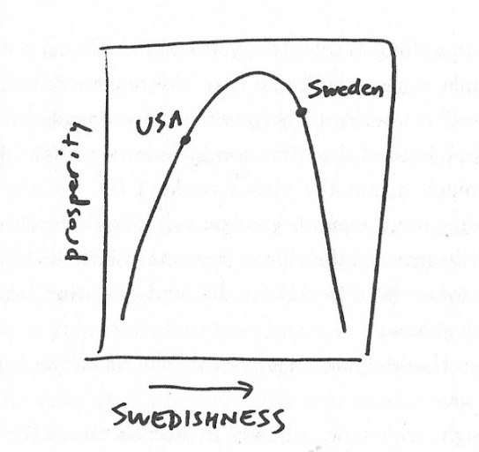
Linearity
It’s important to know what kind of data you have!
Without know the assumptions, you can violate the model’s predictability.
Ellenberg, Jordan “How Not to Be Wrong, The Power of Mathematical Thinking”, 2015 Chapter 1

Slide 8
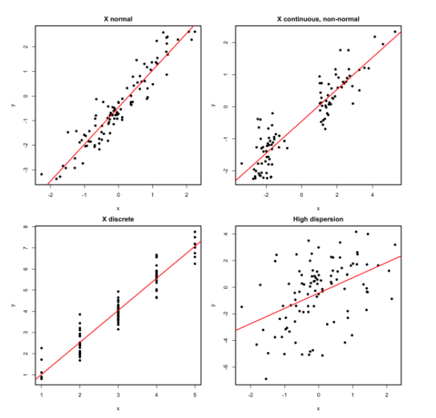
Excercises
Perfectly valid simple linear models (all the assumptions are verified).

Slide 9
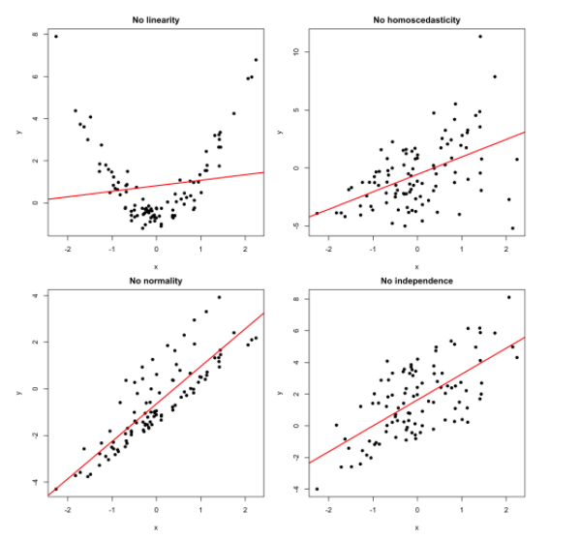
Excercises
Problematic simple linear models (a single assumption does not hold).

Slide 10
Using Matlab
Linear Model
https://www.mathworks.com/help/stats/linearmodel.html
Linear Regression
https://www.mathworks.com/help/stats/fitlm.html

